Slide 1
Boolean Logic and Conditionals

Slide 2
Expressions
Consist of one or more operands connected by one or more operators.
Operands
Variables (x, time): values represented by identifiers that can be changed
Constants (e, PI): values represented by identifiers that cannot be changed
Literals (5, ‘A’, “hello world”): a value not represented by an identifier
Operators
Comparison (<, >, ==, !=): compares operands and evaluate to a Boolean
Assignment (=, +=, -=): changes the value of the left operand
Arithmetic (+, -, *): evaluates to a value based on the operands
Logical (&&, ||, !): connects or changes the evaluation of expressions

Slide 3
Comparing Data
Relational Operators:
< Less than
> Greater than
<= Less than or equal to
>= Greater than or equal to
Equality Operators:
== Equal to
!= Not equal to
Read left to right
1 < 2 → 1 is less than 2
2 > 1 → 2 is greater than 1

Slide 4
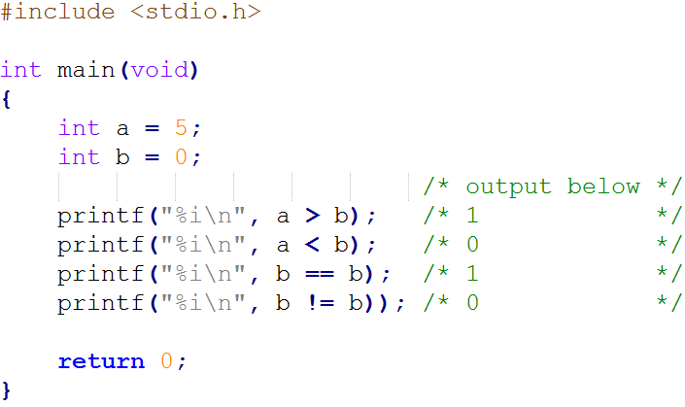
Comparing Data

Slide 5
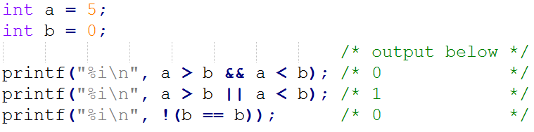
Logical Operators
Making more than one comparison in an expression
&& Logical and (true if this and that are true)
|| Logical or (true if this or that is true)
Negating an expression
! Logical not (Swaps true and false)

Slide 6
Binary vs Unary Operators
Binary
Unary
A + B
A – B
A > B
A < B
A == B
A += B
A -= B
!A
-A
sizeof(A)
++A
--A
A++
A--
The expressions in green evaluate to a value, but do not change the operand(s)
The expressions in red, however, do change their operand(s)

Slide 7

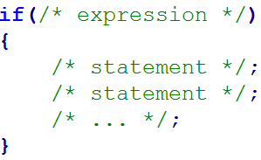
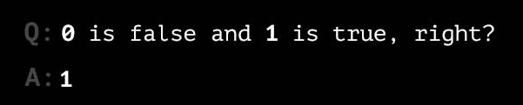
Conditionals
Program can behave in different ways
Simplest conditional – if statement:
Read as: If the expression is true, execute the statement.
true, then execute statement”
Expression is a boolean expressiontes to either true or false
No boolean type in c
Integers 0 and 1 used instead

Slide 8
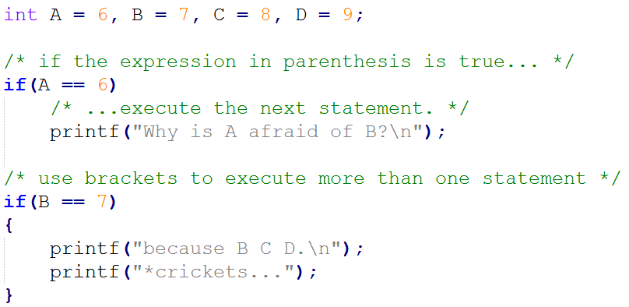
Conditionals

Slide 9
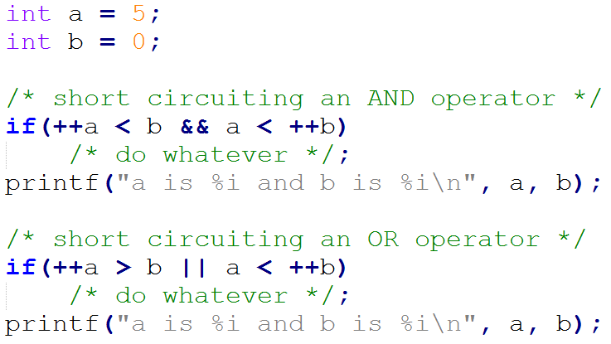
Short Circuit Evaluation
Boolean operators perform short circuit evaluation
A way for the computer to avoid unnecessary work

Slide 10
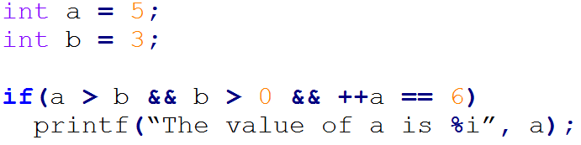
Challenge
Does this print anything? If so, what does it print?
Remember to check precedence!

Slide 11
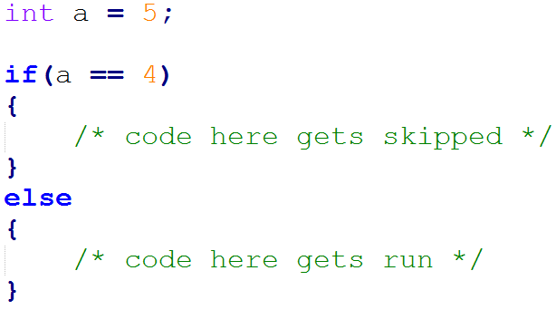
else Clause
Do this if true, otherwise do that
Each if can only have one else
Matches the closest if that hasn't been matched

Slide 12
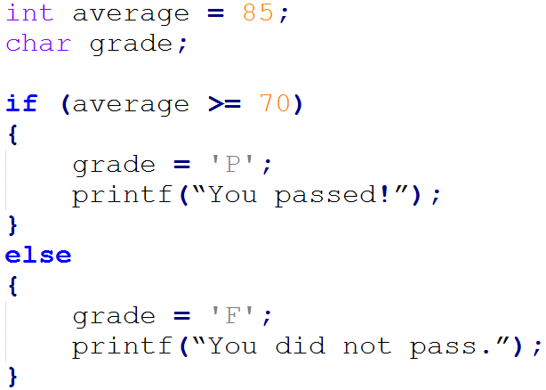
if else Example

Slide 13
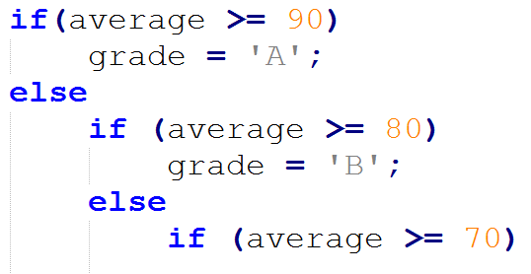
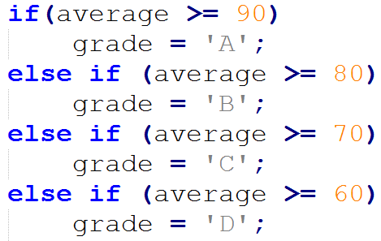
Nested ifs (else if)
incorrect
correct

Slide 14
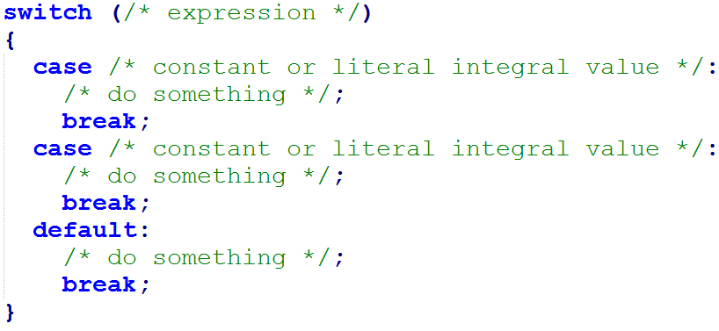
Switch Statement
A shortcut for else ifs
Only works with integers
case is like an else if
default is like an else
break skips the rest of the cases

Slide 15
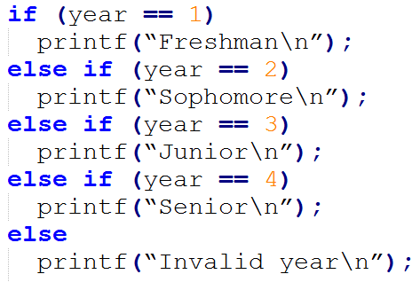
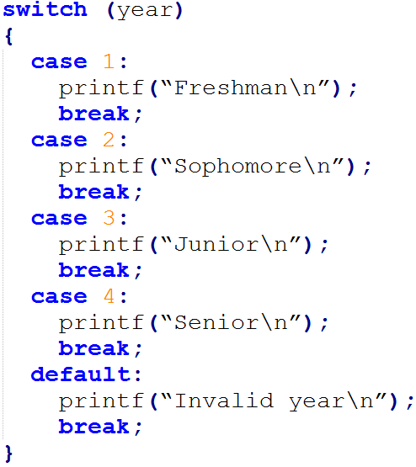
if/else versus switch Example 1
if/else
switch

Slide 16
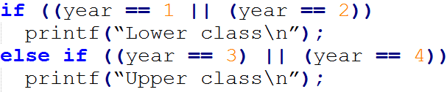
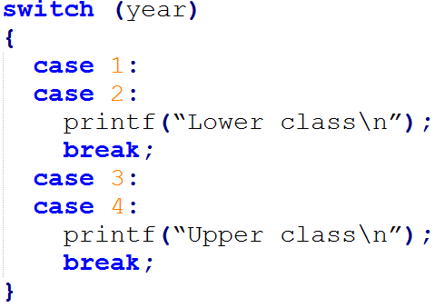
if/else versus switch Example 2

